Slide 1
MASSIVE MIMO Gelareh Haselmehri

Slide 2
OUTLINE
Challenge of Network Traffic Growth
Point-to-Point MIMO
Multi-User MIMO
MASSIVE MIMO
I. Linear Pre-coding and Decoding
II. Channel Estimation
III. Measuring Channel Characteristics
IV. Power Control
Performance of Massive MIMO

Slide 3

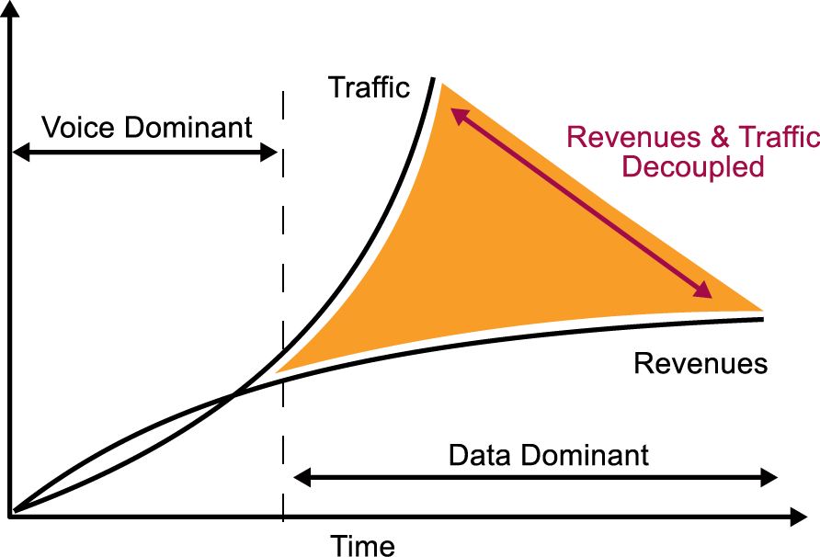
Data Dominant Era − 66% annual growth of traffic − How to achieve in a cost and energy efficient way?
Challenge of Network Traffic Growth

Slide 4

1. exploitation of spectrum that is currently unused or underutilized 2. deployment of ever more access points, each covering a commensurately smaller area 3. use of access points and/or terminals with multiple antennas

Slide 5
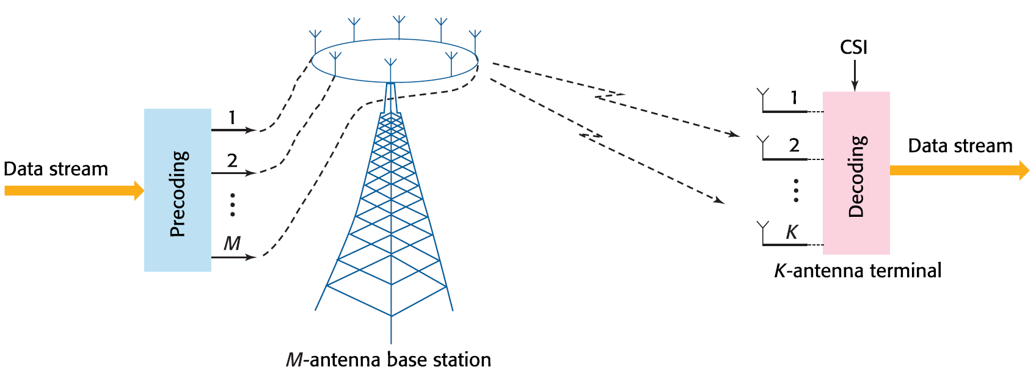

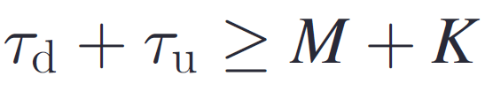
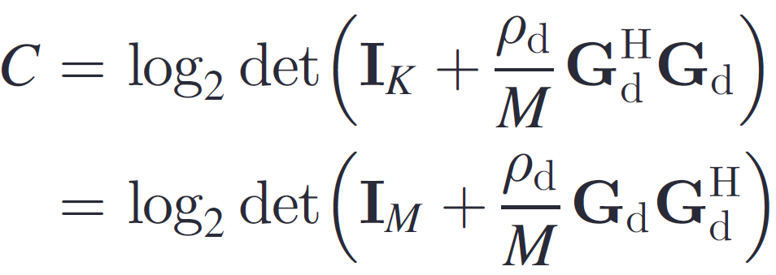

Point-to-Point MIMO
Pilots in downlink and uplink:
Not readily scalable beyond 8×8

Slide 6
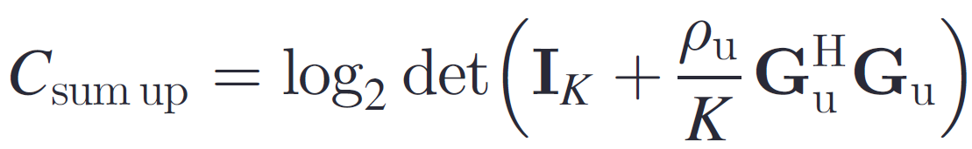
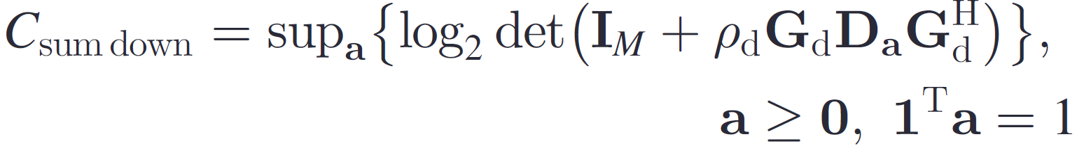
Multi-User MIMO
Single K antenna user
K autonomous single-antenna users
Pilots in downlink and uplink:

Slide 7
Advantages:
Multi-User MIMO is less vulnerable to the propagation environment in comparison with Point-to-Point MIMO
Only single-antenna terminals are required

Slide 8
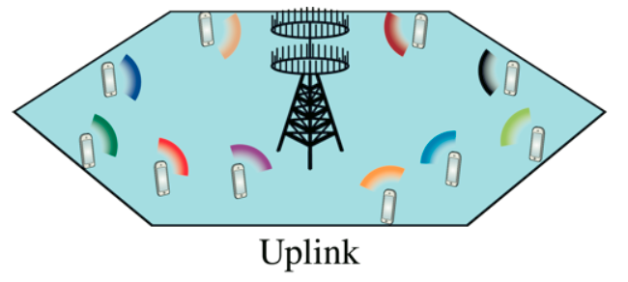
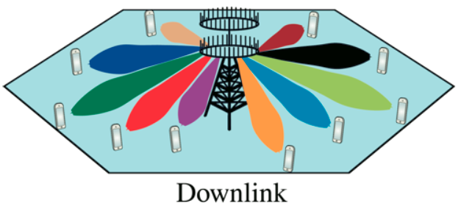
MASSIVE MIMO
Many antennas (𝑀) at BSs
More antennas than users (𝐾)
New key characteristics:
𝑀 ≫ 𝐾: Favorable propagation
Frequency dependence and fast fading disappear
Scalability: Estimation
overhead independent of M
Simple linear precoding and detection
Elegant ergodic capacity analysis

Slide 9
Scalability
Only the base station learns the downlink channel
The number of base station antennas is typically increased to several times the number of users
A simple linear precoding/decoding multiplexing is employed on the downlink/uplink

Slide 10
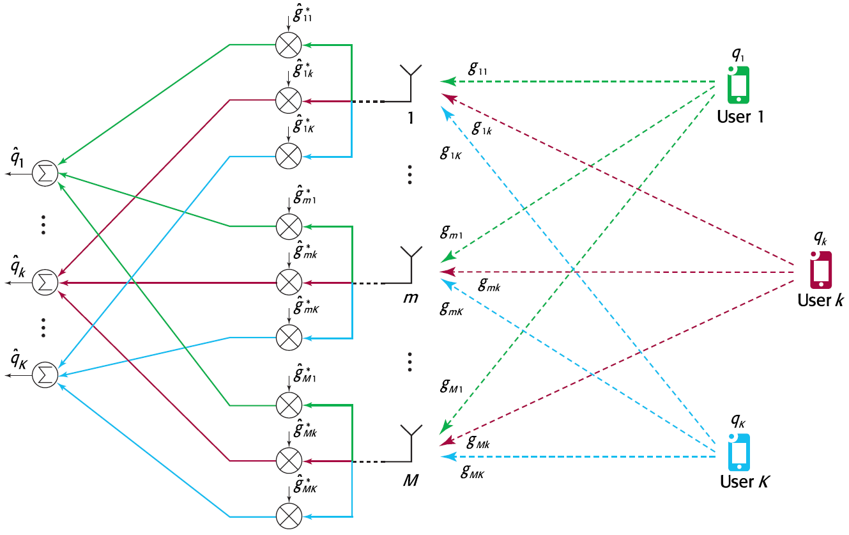
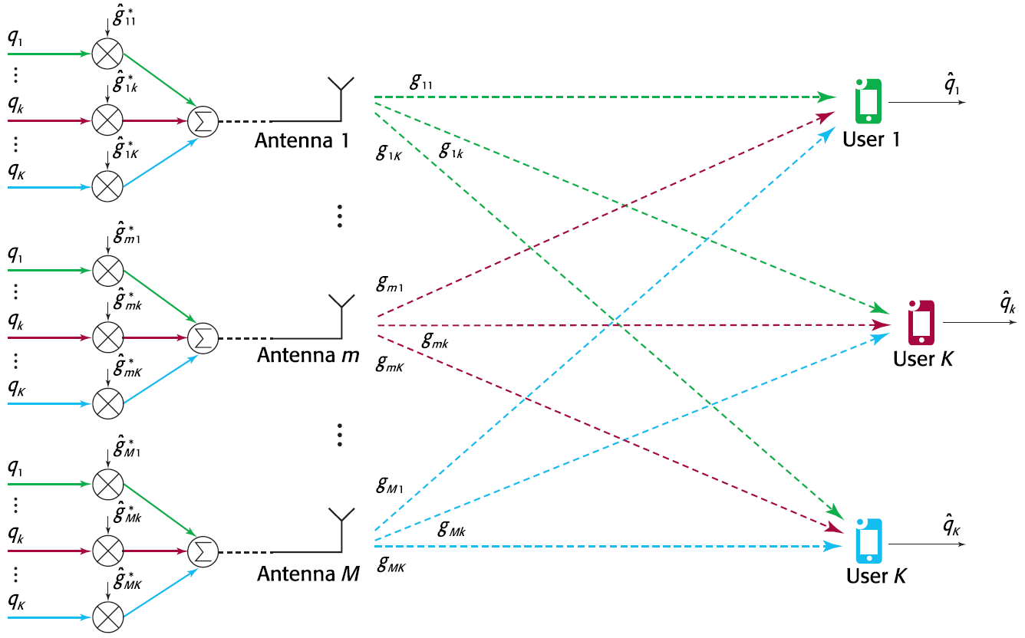
Linear Pre-coding and Decoding
Matched filter decoding for uplink
Conjugate beamforming
for downlink
How do imperfect channel estimates affect the performance of linear pre-coding and decoding?

Slide 11
Advantage:
The Massive MIMO signal processing can be performed locally at each antenna!
Under high SNR conditions, zeroforcing may perform significantly better than matched filtering and conjugate beamforming

Slide 12

Channel Estimation
Transmitting known training signals
Estimating the frequency response
TDD System:
FDD System:

Slide 13
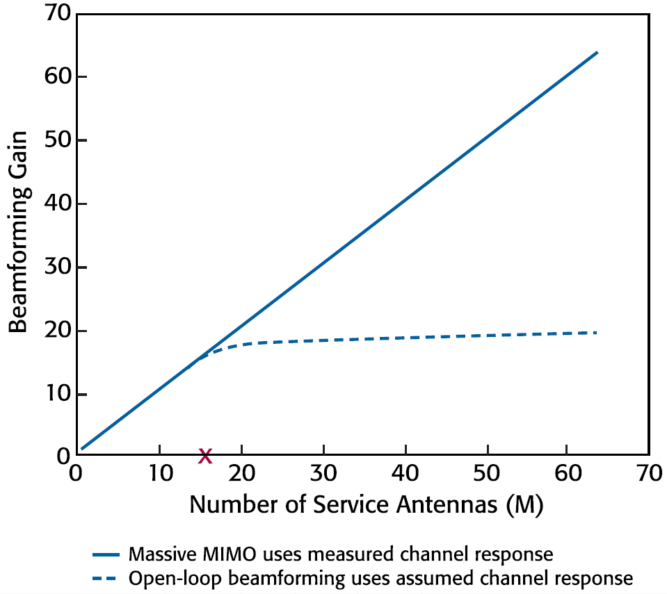
Measuring Channel Characteristics
Makes Massive MIMO a scalable technology!

Slide 14

Power Control
The large number of antennas in Massive MIMO, makes the beamforming gains virtually constant over frequency.
The power control coefficients:
Can be made independent of frequency.
Their effect on the data rate attained by an individual user may be computed without regard to the short term channel estimates obtained from the pilots.

Slide 15
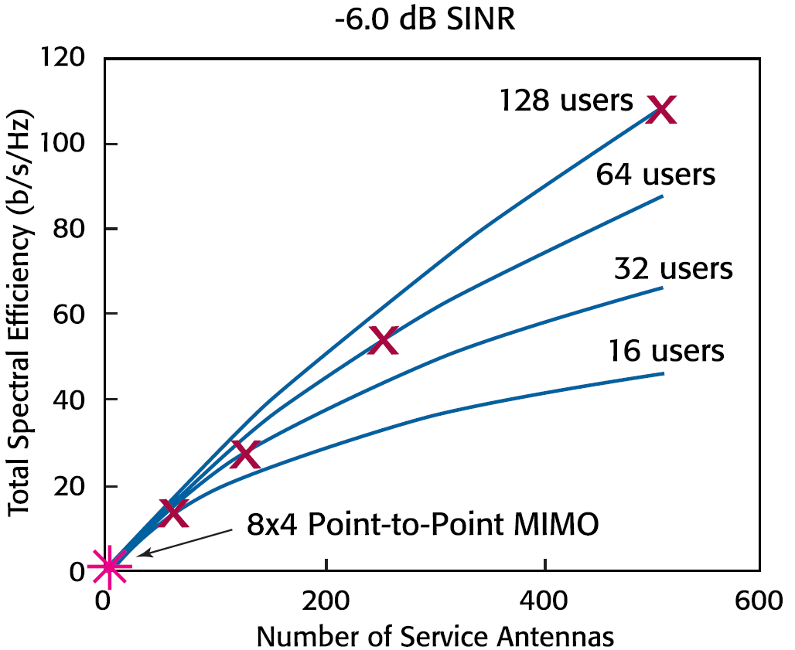
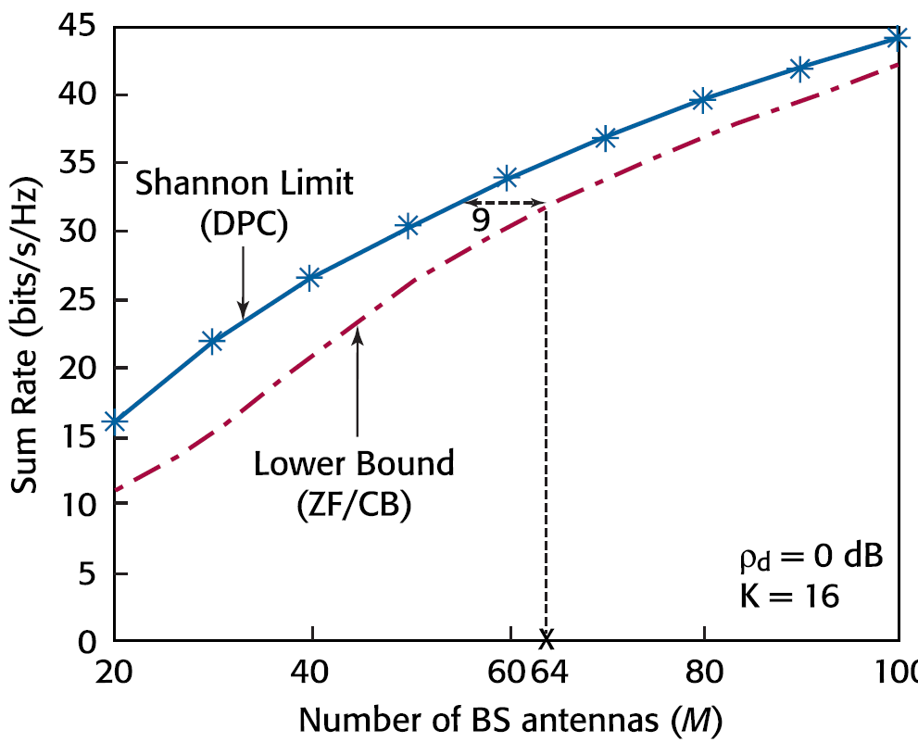
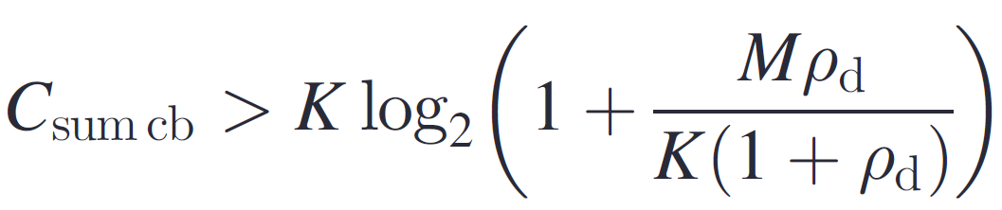
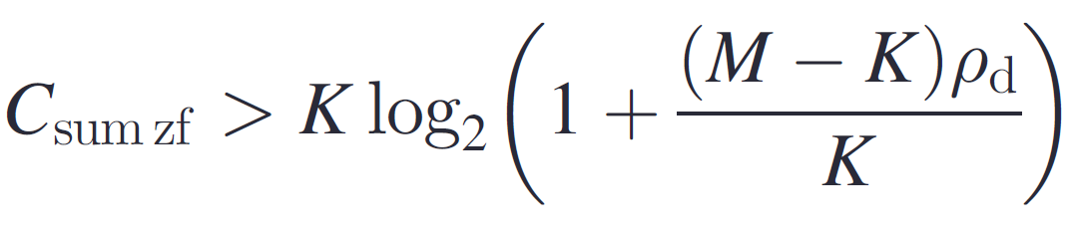
Performance of Massive MIMO
Limitation: There is a finite limit to the number of users that can be served simultaneously.

Slide 16
THANKS!
Any questions?

